Slide 1

goCorona Updater
A JAVA PROJECT

Slide 2
Java City
-Team Logo
-Team Name

Slide 3

Java City Members
01
RAGHAV BHUSHN MISHRA
E20CSE401
02
SHREYANSH MANAV SHUKLA
E20CSE398
03
04
05
SUKETA MEHTA
SWYAM UPADHYAY
SAMARTH SHARMA
E20CSE395
E20CSE392
E20CSE400

Slide 4
Abstract
01
Introduction/ Background
02
Objectives
03
Methods
04
Keywords
As in today’s time covid19 a pandemic disease spreading in all countries our application will give exact live data of cases.
To show Cases, Recovers and Deaths in the form of Bar Chart.
Our Program is a computer application for showing live updates on cases, deaths, and recoveries in the form of flow chart. It shows result of our country input States and as well as of other input countries.
Firstly, sign up or login.
Secondly, input country name and input state name if you want (only for India).
Click submit button.
A bar chart with data will be shown.
For Computer Application, Easy to use, Simple.

Slide 5
Before moving further, Lets Know WTF is object oriented in Java ?
Object-oriented programming: As the name suggests, Object-Oriented Programming or OOPs refers to languages that uses objects in programming. Object-oriented programming aims to implement real-world entities like inheritance, hiding, polymorphism etc in programming. The main aim of OOP is to bind together the data and the functions that operate on them so that no other part of the code can access this data except that function.

Slide 6
01
Introduction,Review of Literature and Background

Slide 7

As in today’s time covid19 a pandemic disease spreading in all countries our application will give exact live data of cases of States (of India) and of other Countries.

Slide 8
02
Objectives: Project Aim

Slide 9
Project Aim
Our project aims towards helping people and giving them live data as per their need and take hand in helping in this pandemic situation,

Slide 10
03
Methods and Materials

Slide 11
Study/Project Design:
Used Specification:
Our project was made in eclipse java platform which helped a lot in giving it a good user interface.
We used Spring Boot which provided spring frame works to it.
We used method of calling API for online data.
We used JFreeChart for getting chart.

Slide 12
Outcome Measures:
Data Collection and Analysis:
Our program gives you data in the form of bar chart which can be zoom in to view the exact cases.
.
Our data of States is provided by api https://api.rootnet.in/covid19-in/stats/latest
Our data of Country is provided by api https://covid.mathdro.id/api

Slide 13
Conclusion:
Our application is good if you want a bar chart data of covid19.

Slide 14
04
Potential Impact and Future Plan

Slide 15

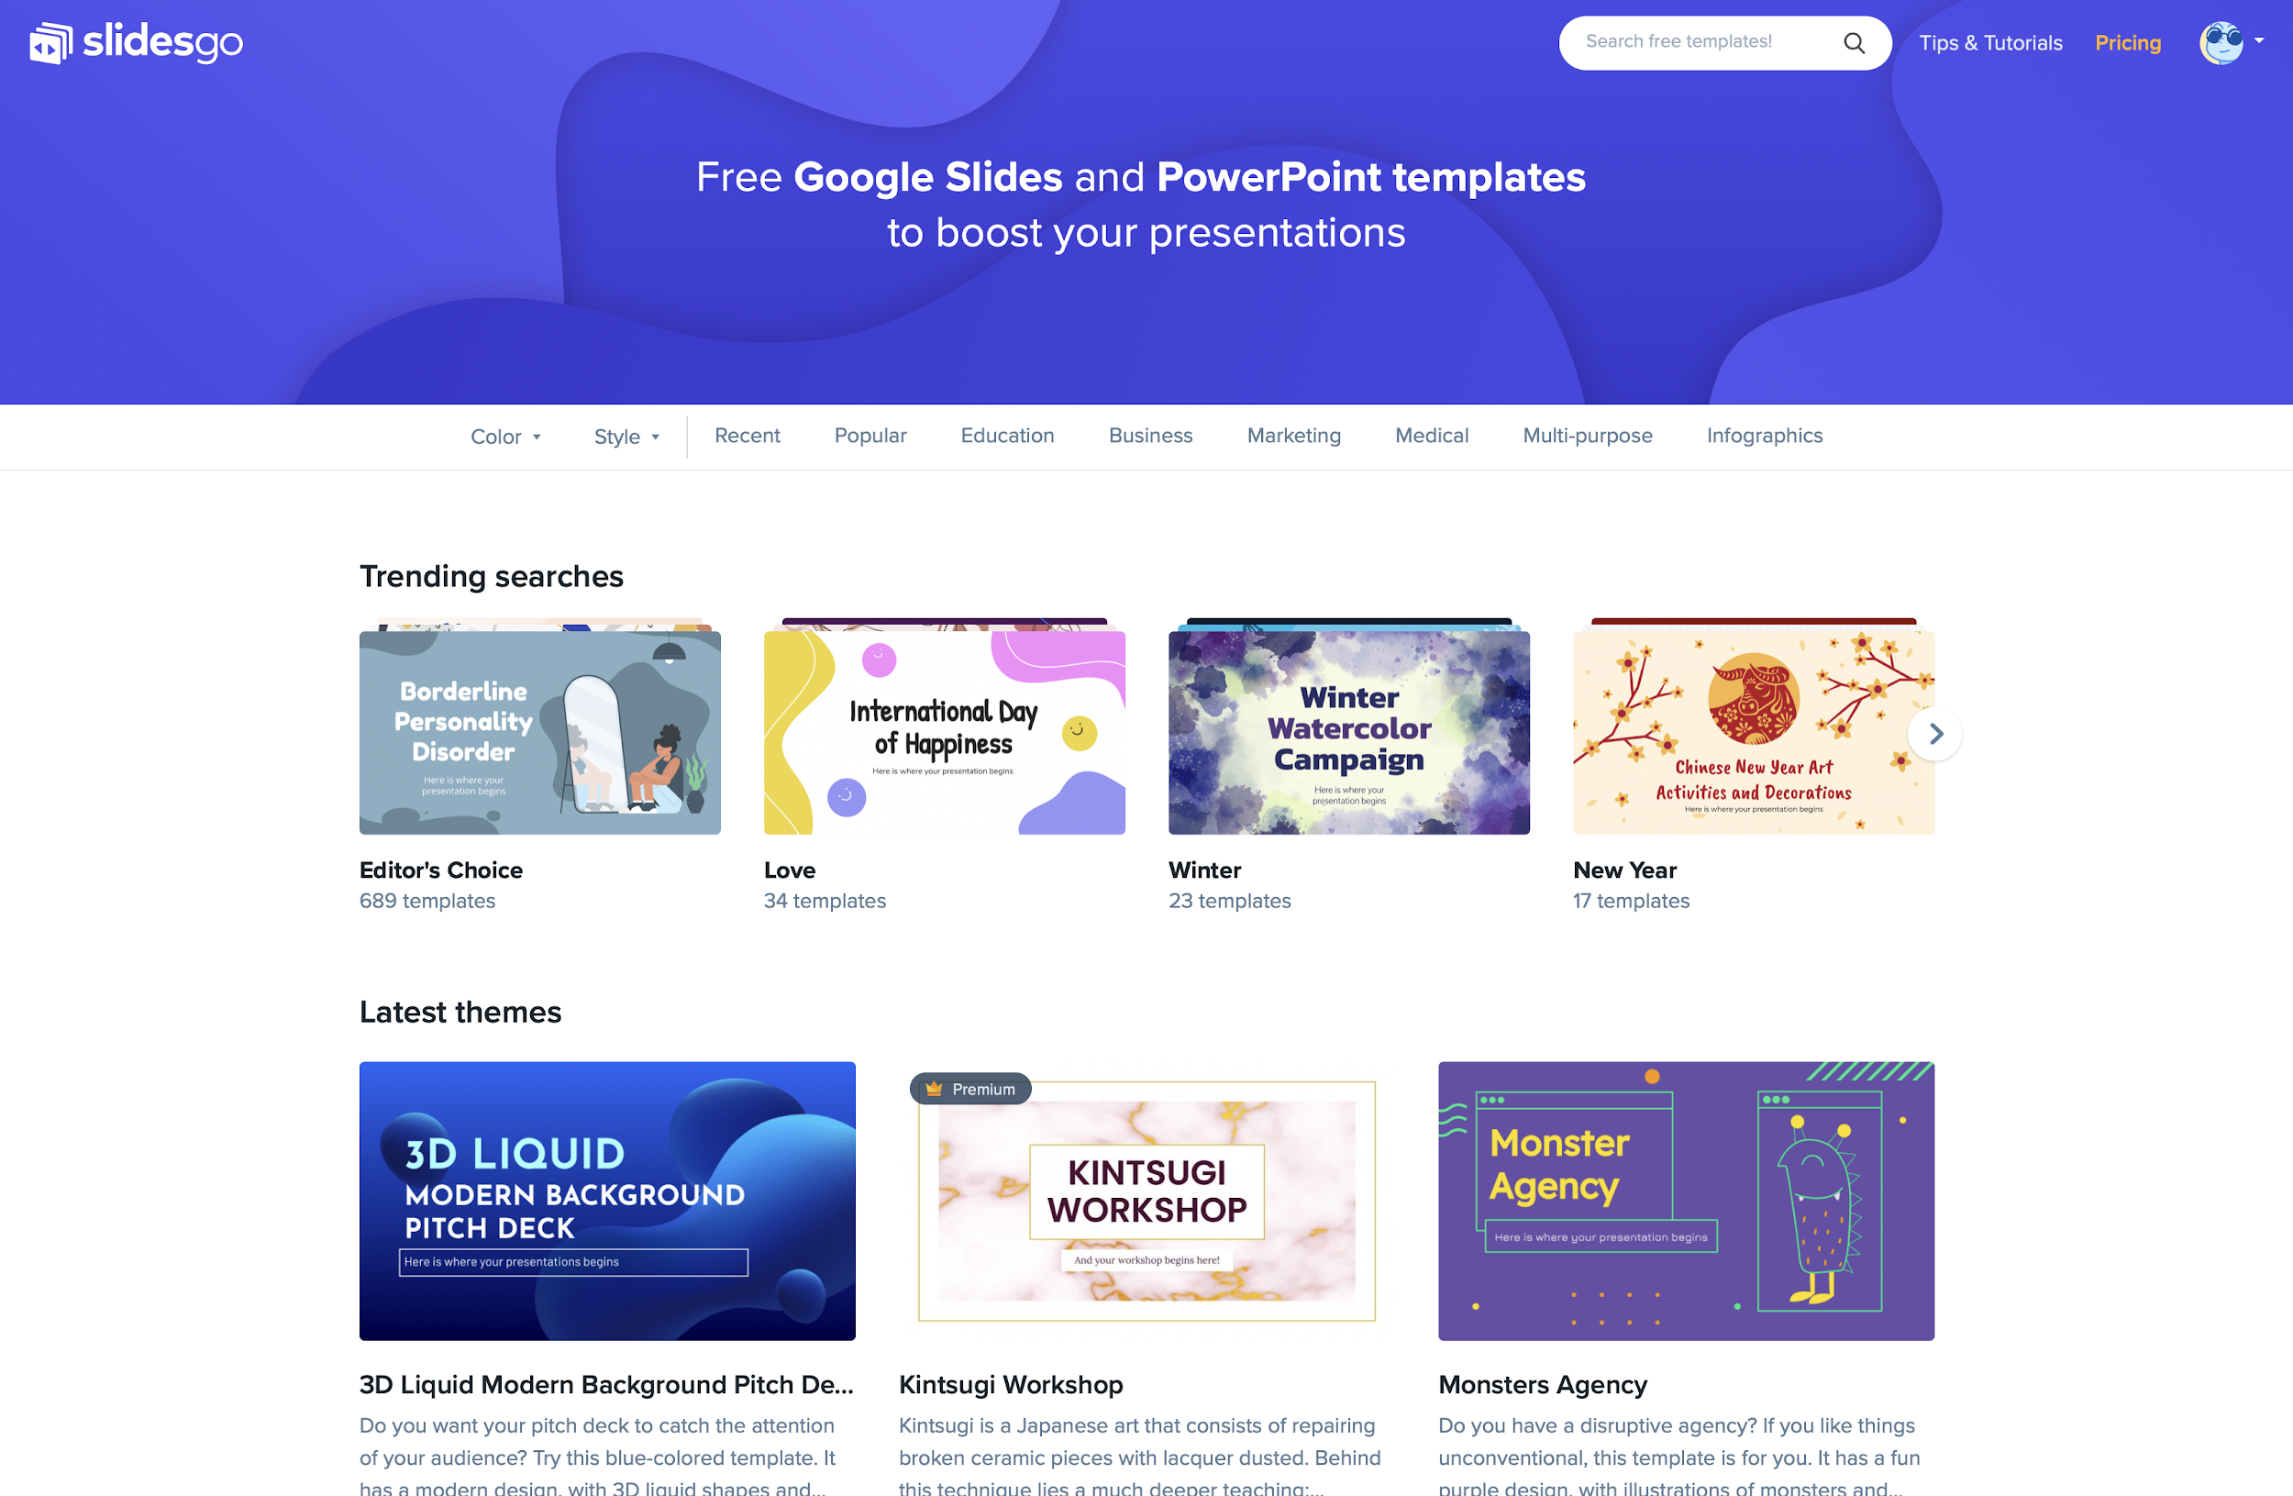
Impact
Our program is good “computer” application.
It will provide precise data and help everyone to know the country wise, state wise covid data.

Slide 16

Future Plans
We will provide some live news flashing in the screen related to covid19, provide link to donate money to PMcares covid19 relief fund.
And we will update it to show data of your location(state) using IP address API.

Slide 17

Refrences
Calling API https://youtu.be/do5GjbJG998
Swing in Java https://www.youtube.com/watch?v=Tch-CpttcOc&list=PLH9iLcrNpXtRhovgmuZD-bWexeOv2H5tW&index=18
JFreeChart https://www.youtube.com/watch?v=RUDrjqywD1g&t=384s

Slide 18



Our team members contribution
Raghav Mishra
Shreyansh Manav Shukla
Suketa Mehta
Outer Help, API’s,
Compiling and interpreting codes , UI
Program related write ups and slides

Slide 19


Swyam Upadhyay
Samarth Sharma
Errors Rectified, Youtube , Slides
Using useful API’s in codes

Slide 20


Thanks!
Stay Safe

